Slide 1

New Technologies. Trends in IT
.

Slide 2
Vocabulary Practice: Trends and fads - they come and go 1. Look at the features below. Decide which describe a fad (F) and which describe a trend (T).
a) society adopts it even though it seems impractical or useless
b) has the power to shape the future of the market
c) doesn’t spread equally everywhere and not at the same pace
d) the process during which the mainstream accepts it is long
e) leads to the development and introduction of other products/services
f) doesn’t particularly correspond to the changes in society
g) can be a game-changer but fades away fast
h) is limited to some parts of the market
i) results in a short-term success for some products
j) may be connected with changing people’s lifestyle, needs or behaviour

Slide 3
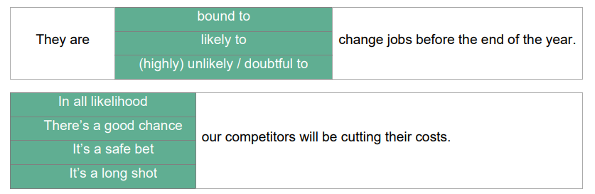
2. Check the expressions below and use them in the next task.

Slide 4
3. Look at the list of present and past products, services, concepts and activities. Which do you think are trends? Which are fads? Why?
• 360 video and photography
• veganism
• electric cars
• Tik Tok
• 3D printing
• Facebook reactions
• podcasts for personal / company branding
• digital assistants (Siri/Cortana)
• virtual reality
• Internet of Things
• remote work
• using influencers for advertising
• infographics
• e-sports (online gaming)
• eco-friendly products and companies
• vaping (e-cigarettes)
• online education

Slide 5
4. Discuss these questions.
a. What do you think a trend is?
b. What trends in ICT do you think will affect our lives in the future? Make a list.

Slide 6
5. Discuss some emerging trends in IT. Which ones do you believe will have a major impact on humanity’s future & our lives? Why?
1. Machine Learning
2. Internet of Things
3. Block Chain
4. Quantum Computing
5. 3D Printing
6. Robotics
7. Biometrics
8. Augmented Reality (AR)
9. Artificial Intelligence
10. Virtual Intelligence
11. Virtual Reality (VR)
12. Drones – Business
13. Autonomous Vehicles

Slide 7
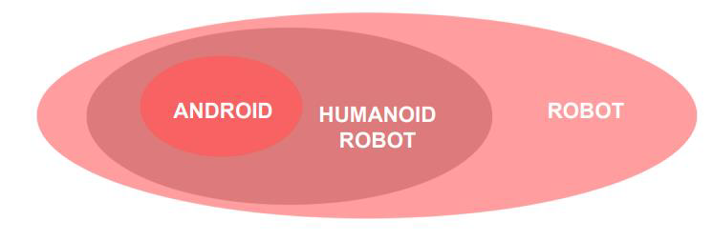
6. Look at the terms below and try to explain the difference between them.

Slide 8
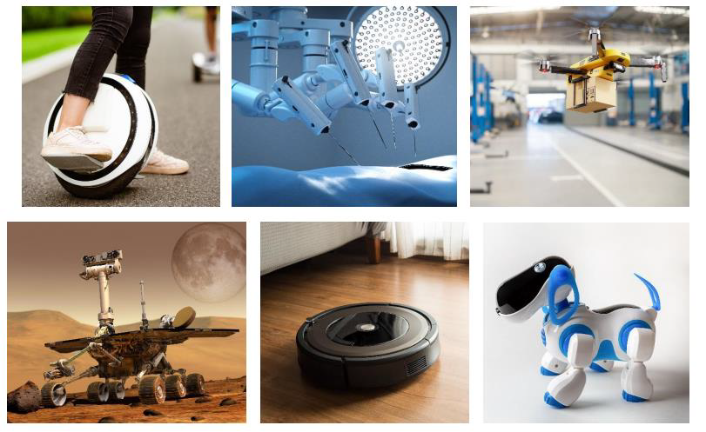
7. Look at the photos and discuss the questions below.

Slide 9
.
• How do the robots shown in the photos change our lives?
• Can you imagine what the world would look like without them?
• Do you think robots might be better than humans at some activities? Which ones?
• Do you think we will see more androids in the future? Why (not)?
• Have you heard of any interesting new robots?

Slide 10
8. In pairs, discuss these predictions. Do you agree or disagree? Give reasons for your answers.
a. Some day, we’ll be talking to computers naturally, like friends.
b. Microchips implanted in our arms will serve as ID cards and contain our medical records.
c. Robots will learn to build themselves, without human help.
d. Smart homes will be voice-activated.
e. Computers will be ubiquitous and almost invisible, embedded into our homes and integrated into our lives.

Slide 11
Vocabulary Practice: The next big thing after smartphones 1. Match the pairs of synonyms.
1) out-of-date
2) combine
3) almost not
4) quick
5) insert
a) Barely - 3
b) Embed - 5
c) Merge - 2
d) Obsolete - 1
e) Swift - 4

Slide 12
2. Complete the gaps with the correct form of words a–e.
a) …………………… technologies and people is only a dystopian future.
b) In countries like Sweden, cash is becoming …………………… .
c) Microchipping is simple and ……………………: you can do it within seconds.
d) The process of …………………… a microchip under your skin is painful.
e) People are …………………… concerned about the negative effects of microchipping.
EMBEDDED
OBSOLETE
SWIFT
MERGING
BARELY

Slide 13
3. Discuss the questions.
• Would you be willing to have a microchip embedded under your skin? Why/Why not?
• What would your main concern be?
• Do you think microchipping will be available everywhere in the world soon?
• What might the next step of merging technology and people look like?

Slide 14
4. Think of four possible applications of microchipping in any of the following areas. Present your applications and discuss the advantages and disadvantages of each
• identification
• medicine
• finance
• entertainment
• education
• communication

